Slide 1
SAP Gateway
Day 6
<Trainer>
Capgemini, India

Slide 2
SAP Gateway Day 6 - Agenda
Consumption of CDS in Fiori
CDS Annotations
Odata service generation from CDS

Slide 3
Consumption of CDS View
Consumption of CDS can be done in the following ways:
In a CDS View
By Open SQL
Data Preview (context menu in ADT)
SAP List Viewer
SAP NetWeaver Gateway (OData Model)

Slide 4
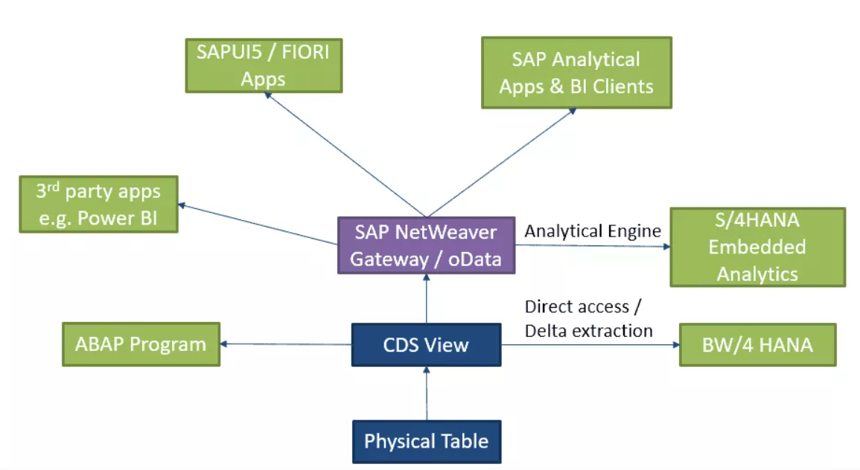
CDS Views consumption

Slide 5
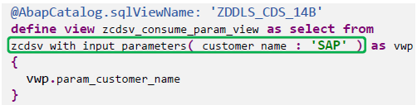
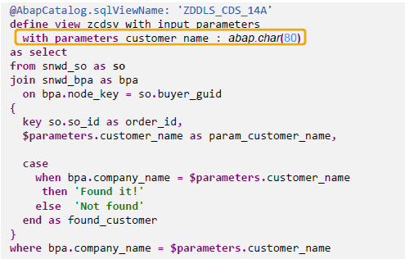
Consumption of CDS View
Consumption of CDS View in CDS View:
You can create CDS view on another CDS View(called as the Base View)
View on View is nothing but the consumption of CDS View in another View

Slide 6
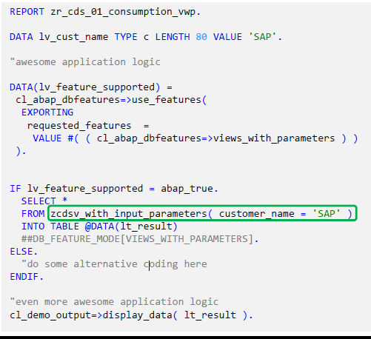
Consumption of CDS View
CDS View is consumed via OpenSQL using below 4 steps
Check if the feature is supported :abap_true
Provide (mandatory) input parameter(s) :Customer_name
Suppress syntax warning using the pragma ##
Provide a “fallback“ implementation / some error handling : ELSE

Slide 7
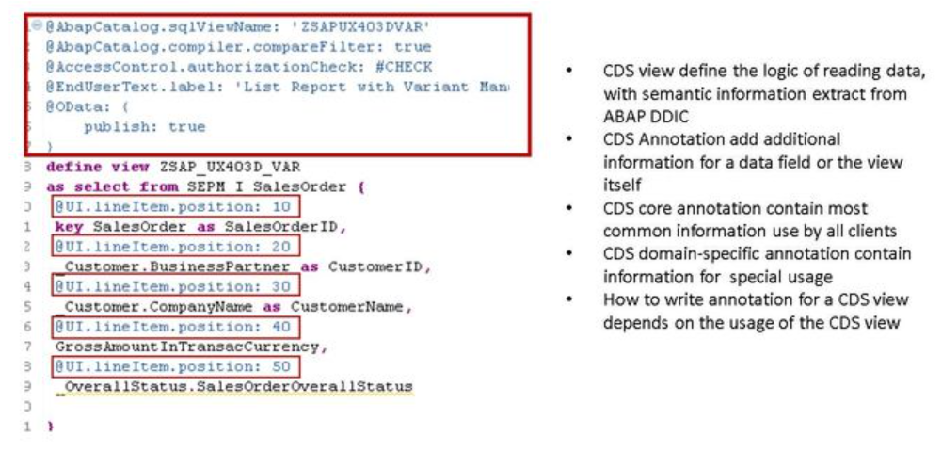
CDS Annotations

Slide 8
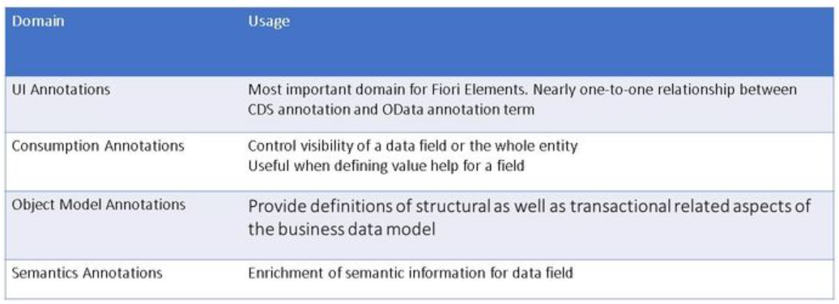
CDS Annotations
CDS annotations are extra information to describe the data, it let the consumer of CDS view know how to use data from the CDS view.
Annotations are grouped according to usage, this figure shows most relevant groups of association for Fiori Elements.

Slide 9
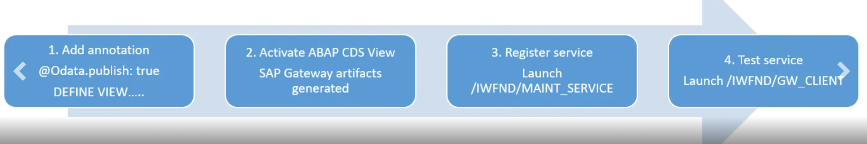
Odata Service generation from CDS
SAP Gateway OData service for an ABAP CDS view can be generated using annotation @OData.publish: true
CDS view should meet following rules for successful OData service generation:
No syntax errors in DDL source code.
At least one key element is defined in the SELECT list of the CDS view.
The name of the CDS view should not exceed 26 characters in length.

Slide 10
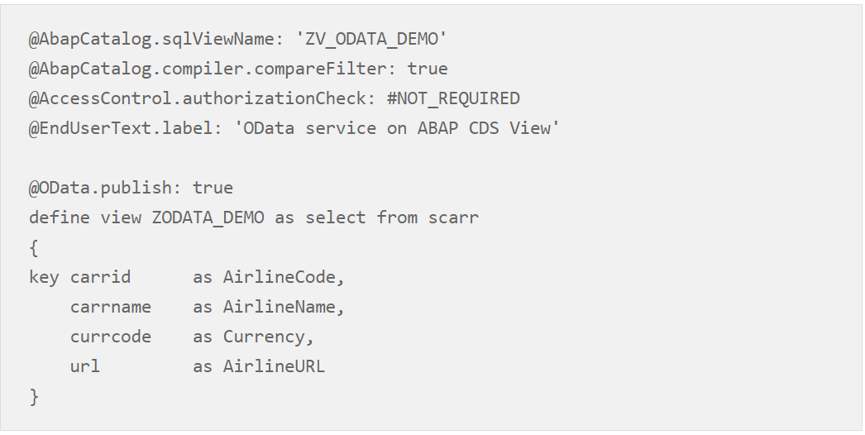
Odata Service generation from CDS
Add the annotation @OData.publish: true above the DEFINE VIEW statement

Slide 11
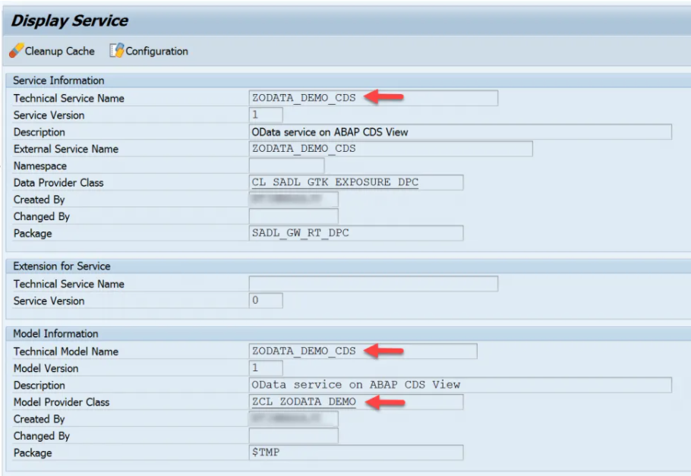
Odata Service generation from CDS
On activating the CDS view, following Gateway artifacts will be generated by the SADL framework in back-end server.
Technical service name artifact – <cds_view_name>_CDS.
Gateway Model artifact with name – <cds_view_name>_CDS.
ABAP class with name – CL_<cds_view_name>.
You can find all these artifacts in the transaction code – “/IWBEP/REG_SERVICE”

